Slide 1
Chapter 3: Requirements Determination

Slide 2
Learning Objectives
Learn how to create a requirements definition
Learn various requirements analysis techniques
Learn when to use each requirements analysis techniques
Learn how to gather requirements using interviews, JAD sessions, questionnaires, document analysis & observation
Learn various requirements documentation techniques such as concept maps, story cards & task-lists
Understand when to use each requirements-gathering technique
Be able to begin the creation of a system proposal

Slide 3
Introduction-SDLS
SDLC : Planning, Analysis, Design, Implementation
2.Analysis
3.Design
System
proposal
1.Planning
System request
+feasibility analysis result
+project plan
System
specification
4.Implementation
System

Slide 4
Introduction-planning
1.2.Feasibility analysis
1.1 Project identification
Feasibility analysis result
System request
Project plan
1.3Create workplan
Planning = project initiation + project management
Project plan = workplan + staffs + techniques

Slide 5
Introduction
The systems development process transforms the existing (as is) system into the proposed (to be) system
Requirements determination
The single most critical step of the entire SDLC
Changes can be made easily in this stage
Most (>50%) system failures are due to problems with requirements
The iterative process of OOSAD is effective because:
Small batches of requirements can be identified and implemented incrementally
The system will evolve over time

Slide 6
Requirements Determination
Purpose: to convert high level business requirements (from the system request) into detailed requirements that can be used as inputs for creating models
What is a requirement?
A statement of what the system must do or a characteristic it must have
Will later evolve into a technical description of how the system will be implemented
Types:
Functional: relates to a process or data
Non-functional: relates to performance or usability

Slide 7
Introduction
System request
Feasibility analysis result
Functional requirements
2.1Requirements
Determination
Project plan
Nonfunctional requirements
CH2
CH2, CH3, CH4, CH5
information
Functional requirements + Nonfunctional requirements = requirement definition = system proposal
Nonfunctional requirements 는 설계단계에서 반영됨

Slide 8
Requirements Definition
Functional & non-functional requirements listed in outline format
May be prioritized
Provides information needed in subsequent workflows
Defines the scope of the system

Slide 9
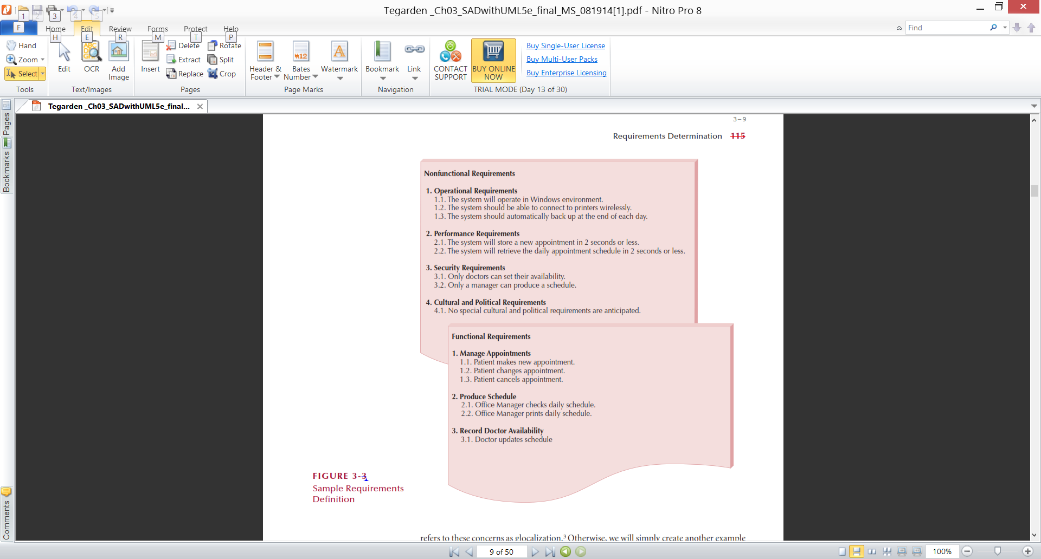
Sample of Requirements Definition

Slide 10
Determining Requirements
Business & IT personnel need to collaborate
Strategies for problem analysis:
Root cause analysis
Duration analysis
Activity-based costing
Informal benchmarking
Outcome analysis
Technology analysis
Activity elimination
Notes:
IT person 단독으로 하면 비즈니스 가치가 없는 시스템을 만들고
Biz people 들 단독으로 수행하면 잘못된 biz process를 그대로 전산화한다. – 매우 비 효율적인 시스템을 만든다.
따라서 같이 해야한다.

Slide 11
Determining Requirements
Requirements are best determined by systems analysts and business people together
Techniques for identifying requirements
Interviews, questionnaires and/or observation
Joint application development (JAD)
Document analysis
Notes:
사업/ 분석가가 같이 해야 최고다

Slide 12
Creating a Requirements Definition
Determine the types of functional and non-functional requirements applicable to the project
Use requirements-gathering techniques to collect details
Analysts work with users to verify, change and prioritize each requirement
Continue this process through analysis workflow, but be careful of scope creep
Requirements that meet a need but are not within the current scope can be added to a list of future enhancements
Notes:
기능 비기능을 정한다.
요구 수집 기술을 을 이용한다.
분석가는 요구를 검증하고 변경하고 우선순위를 정한다. 사용자와 함께
Scope를 제한한다.
필요하지만 이번 시스템에 포함되지 않는 것은 향후 게획으로 넘긴다.

Slide 13
Problems in Requirements Determination
Analyst may not have access to the correct users
Requirements specifications may be inadequate
% Lightweight techniques associated with agile methodologies인 경우 특히 많다.
Some requirements may not be known in the beginning
% 점진적, 반복적 기법으로 해결
Verifying and validating requirements can be difficult
% Functional, structural, behavioral model을 만들 때 다룰 예정
Notes:
정확한 사용자를 파악하기 힘들며
부적절한 요구 명세가 있을 수 있다.
처음에는 요구가 모두 나타나지 않는다. 점진적, 반복적으로 해결
검증이 힘들지만 아키텍쳐를 만들 때 검점한다.

Slide 14
Requirement gathering & requirements analysis strategies
CH2
System request
Feasibility analysis result
Functional requirements
2.1Requirements
Determination
Project plan
Nonfunctional requirements
information
Requirements gathering techniques
Requirements analysis strategies
Kind of information that is gathered

Slide 15
Requirements Analysis Strategies
Problem analysis – 현 시스템의 문제점과 개선방안을 사용자에게 물어보는 방법.
Ask users to identify problems with the current system
Ask users how they would solve these problems
Good for improving efficiency or ease-of-use
Root cause analysis – 개선 방안 말고 문제의 원인 분석.
Focus is on the cause of a problem, not its solution
Create a prioritized list of problems
Try to determine their causes
Once the causes are known, solutions can be developed

Slide 16
Requirements Analysis Strategies(Cont.)
Duration analysis – % 업무 수행 시간 측정
Determine the time required to complete each step in a business process
Compare this to the total time required for the entire process
Large differences suggest problems that might be solved by:
Integrating some steps together
Performing some steps simultaneously (in parallel)
Activity-based costing - % duration analysis에서 비용을 측정
Same as duration analysis but applied to costs
Informal benchmarking – 다른 곳 보고 뻬끼기
Analyzes similar processes in other successful organizations

Slide 17
Requirements Analysis Strategies(Cont.)
Outcome analysis – 고객이 진짜로 원하는 것 : 보험금 수령이 아니라 차수리 이면 차 수리 서비스를 제공?
What does the customer want in the end?
Technology analysis – 새로운 기술의 도입이 도움이 ?
Apply new technologies to business processes & identify benefits
Activity elimination – 구조 조정 : 업무과정 생략 가능?
Eliminate each activity in a business process in a “force-fit” exercise

Slide 18


Requirements Analysis Techniques
Business process automation (BPA)
Doesn’t change basic operations
Automates some operations
Business process improvement (BPI)
Focus on improving business processes
Business process reengineering (BPR)
Focus on new ideas and new ways of doing business

Slide 19
Business Process Automation
Business process automation (BPA)
Doesn’t change basic operations
Automates some operations
BPA Techniques
Problem Analysis
Asking the users and manager to identify problems with the as-is system and to ask how to solve them in the to-be system
Root Cause Analysis
Users tend to jump quickly to solutions without fully considering the nature of the problem
Focuses on problems, not solutions
The analysts generate all the possible root causes for each problem

Slide 20
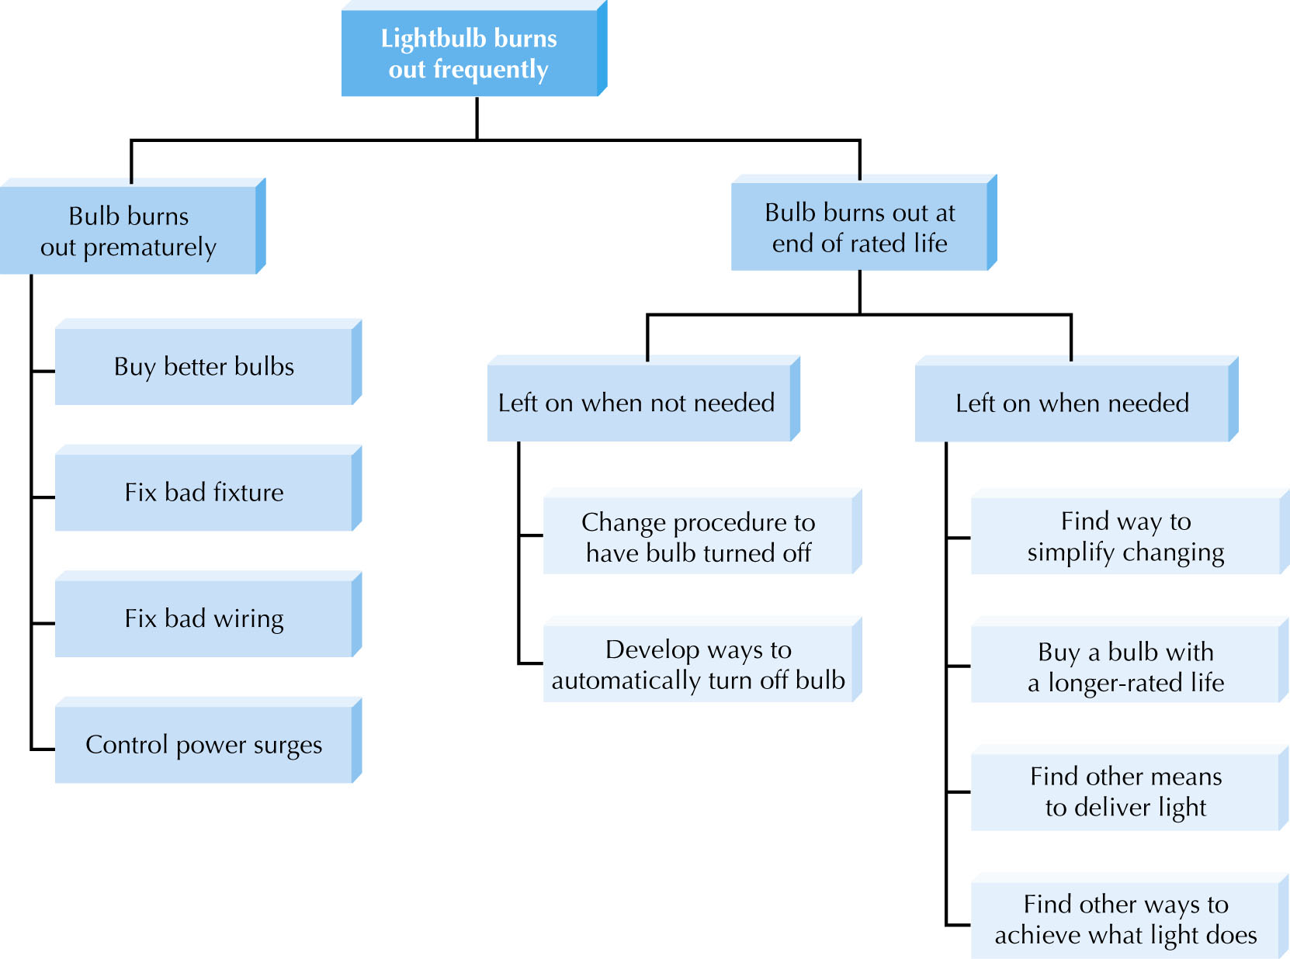
fig_04_03
Example of Root Causes

Slide 21
Business Process Improvement
Business process improvement (BPI) changes
Focus on improving business processes
Changes operation with new techniques
Can improve efficiency and effectiveness
Duration Analysis
Time to perform each process and sub-process
Compare difference between two totals
Activity-Based Costing
Examines most costly processes
Focus on their improvement efforts on them
Informal Benchmarking
Studies how other organizations perform business processes as customers

Slide 22
Business Process Reengineering
Focus on new ideas and new ways of doing business
Outcome Analysis
Understanding the fundamental outcomes that provide value to customers
Technology analysis
Identifies how each technology could be applied to the business process
Identifies how the business would benefit
Activity Elimination
Identifies how the organization could eliminate each activity in the business process, how the function could operate without it, and what effects are likely to occur

Slide 23
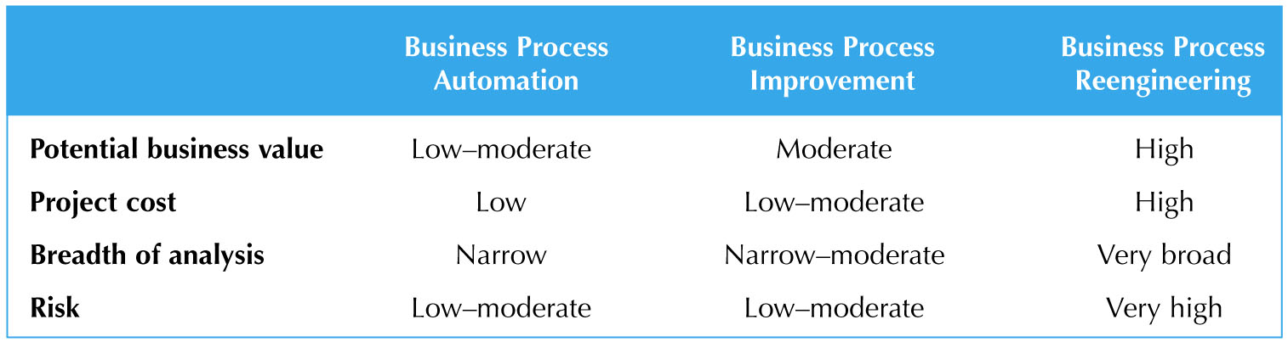
Analysis Characteristics

Slide 24
Requirements Gathering Techniques
Process is used to:
Uncover all requirements (those uncovered late in the process are more difficult to incorporate)
Build support and trust among users
Which technique(s) to use?
Interviews
Joint Application Development (JAD)
Questionnaires
Document analysis
Observation

Slide 25
Requirements Gathering
Interviews,
JAD,
Questionnaires,
Document Analysis, and
Observation.

Slide 26
Interviews
Most popular technique—if you need to know something, just ask

Slide 27
Interviews -- Five Basic Steps
Selecting interviewees
Designing interview questions
Preparing for the interview
Conducting the interview
Post-interview follow-up

Slide 28
Selecting Interviewees
Based on information needed
Often good to get different perspectives
Managers
Users
Ideally, all key stakeholders
The people who can affect the system or who will be affected by the system

Slide 29
Types of Questions
Types of Questions
Examples
* How many telephone
orders are received per day?
Closed-Ended Questions
* How do customers place orders?
* What additional information
would you like the new system
to provide?
* What do you think about the
current system?
Open-Ended Questions
* What are some of the problems
you face on a daily basis?
* How do you decide what types of
marketing campaign to run?
* Why?
Probing Questions
* Can you give me an example?
* Can you explain that in a bit
more detail?

Slide 30
Designing Interview Questions
Unstructured interview
Broad, roughly defined information
Few close-ended questions to ask
Structured interview
After understanding the business process better, more specific information is needed
More close-ended questions

Slide 31
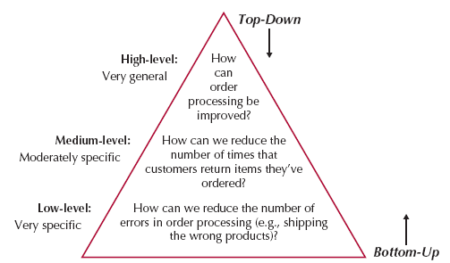
Questioning Strategies
One case in which the bottom-up strategy
may be preferred is when the analyst
already has gathered a lot of information
about issues
bottom-up strategy may be appropriate if lower-level staff members are threatened or unable to answer high-level questions

Slide 32
Interview Preparation Steps
Prepare general interview plan
List of questions
Anticipated answers and follow-ups
Confirm areas of knowledge
Set priorities in case of time shortage
Prepare the interviewee
Schedule
Inform of reason for interview
Inform of areas of discussion

Slide 33
Conducting the Interview
Appear professional and unbiased
Record all information
Check on organizational policy regarding tape recording
Be sure you understand all issues and terms
Separate facts from opinions
Give interviewee time to ask questions
Be sure to thank the interviewee
End on time

Slide 34
Conducting the Interview Practical Tips
Don’t worry, be happy
Pay attention
Summarize key points
Be succinct
Be honest
Watch body language

Slide 35
Post-Interview Follow-Up
Prepare interview notes
Information that was collected over the course of the interview
Prepare interview report
within 48 hours of the interview
Look for gaps and new questions
by interviewee’s review and approval

Slide 36
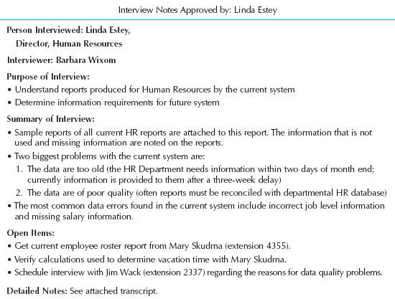
Post-Interview
Prepare notes and send to the interviewee for verification

Slide 37
JOINT APPLICATION DESIGN Joint application Development (JAD)

Slide 38
JAD Key Ideas
Allows project managers, users, and developers to work together
May reduce scope creep by 50%
Avoids requirements being too specific or too vague

Slide 39
Joint Application Design (JAD) Important Roles
Facilitator
sets the meeting agenda and guides the discussion
does not join in the discussion
Scribe
assist the facilitator by recording notes, making copies, etc.
Project team, users, and management

Slide 40
Joint Application Design (JAD) Setting
U-Shaped seating
Away from distractions
Whiteboard/flip chart
Prototyping tools
e-JAD
Networked system to send anonymous ideas and opinions to everyone else

Slide 41
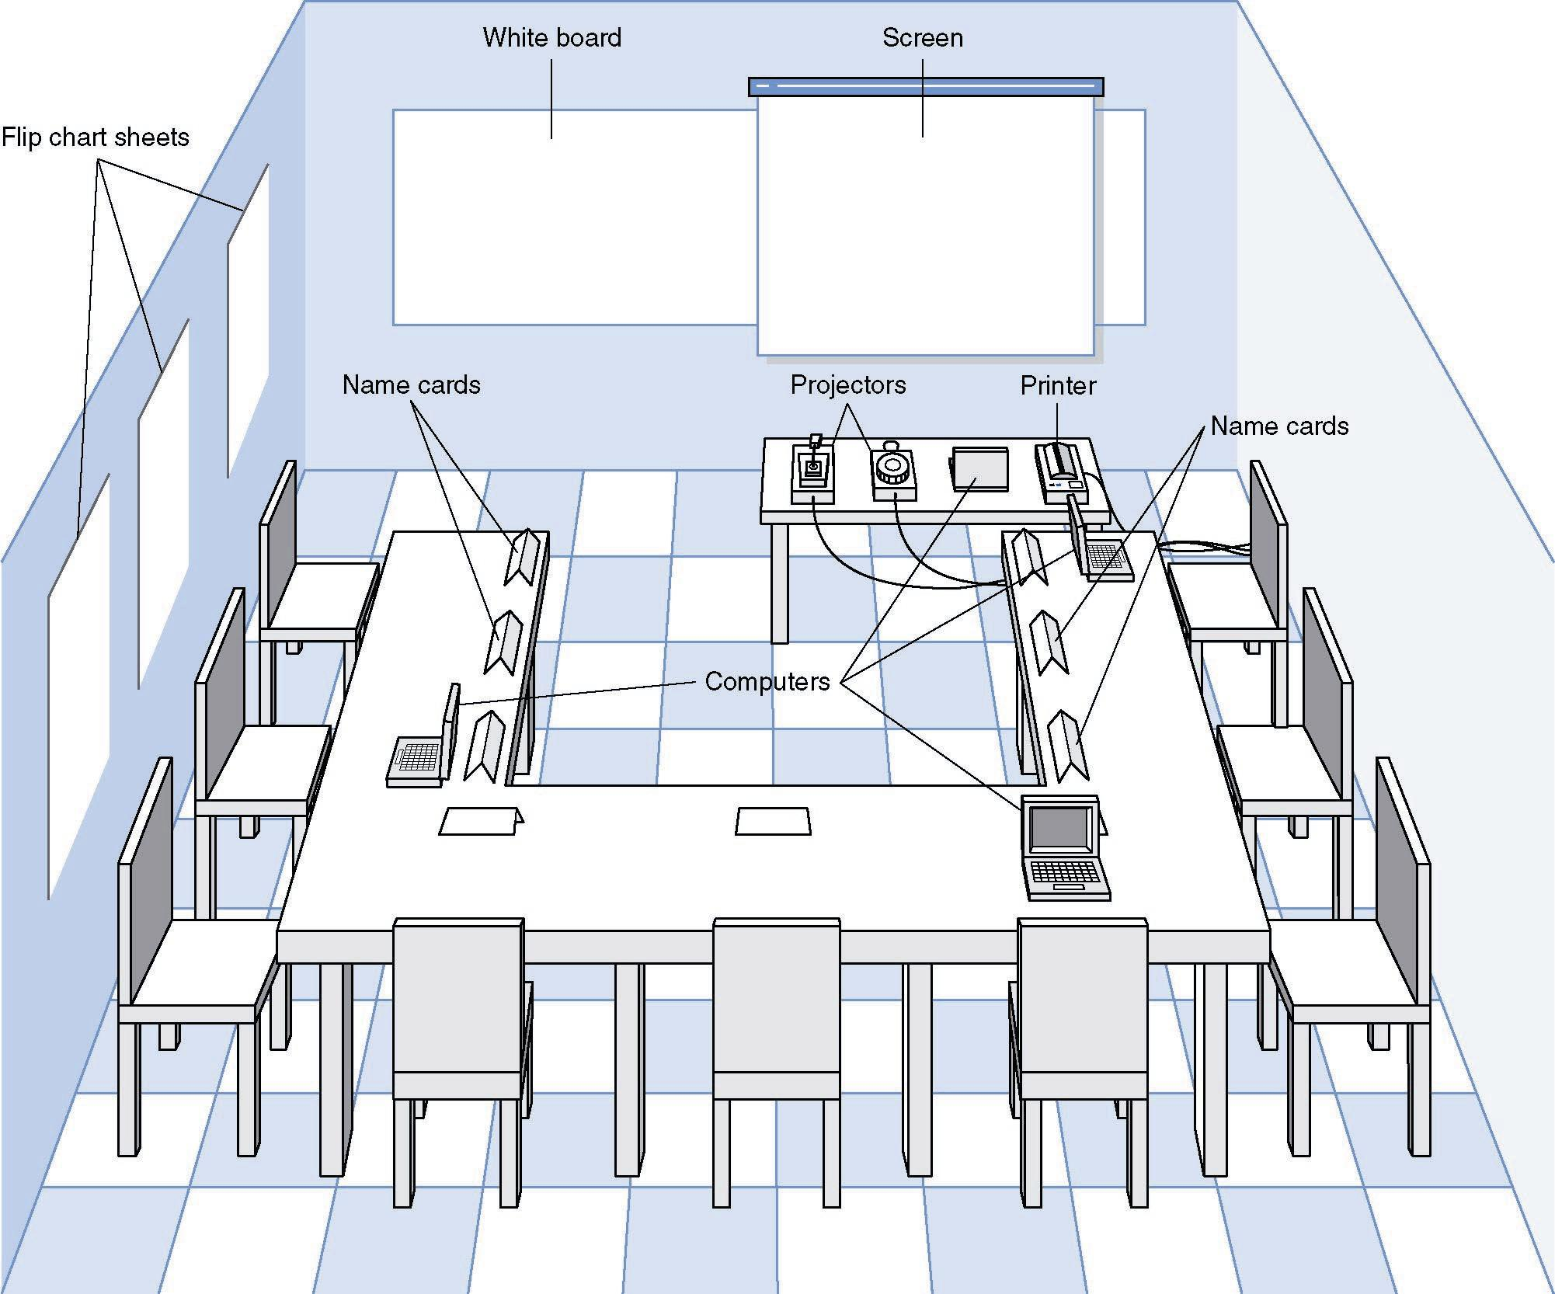
JAD Meeting Room
JPEG Figure 5-5 Goes Here

Slide 42
The JAD Session
Tend to last 5 to 10 days over a three week period
Prepare questions as with interviews
Formal agenda and ground rules
Examples of ground rules : following the schedule, respecting others, opinions, …
Facilitator activities
Keep session on track
Help with technical terms and jargon
Record group input
Help resolve issues
Post-session follow-up
JAD postsession report is prepared and circulated among session attendees

Slide 43
Joint Application Development (JAD)
Joint user-analyst meeting hosted by a facilitator
10 to 20 users
1 to 2 scribes as needed to record the session
Usually in a specially prepared room
Meetings can be held electronically and anonymously
Reduces problems in group settings
Can be held remotely
Sessions require careful planning to be successful
Users may need to bring documents or user manuals
Ground rules should be established

Slide 44
Questionnaires
A set of written questions used to obtain information from individuals
May be paper based or electronic (e.g., web based)
Common uses:
Large numbers of people
Need both information and opinions
When designing for use outside the organization (customers, vendors, etc.)
Typical response rates: < 50% (paper); < 30% (Web)

Slide 45
Questionnaire Steps
Select the participants
Identify the population
Use representative samples for large populations
Designing the questionnaire
Careful question selection
Remove ambiguities
Administering the questionnaire
Working to get good response rate
Offer an incentive (e.g., a free pen)
Questionnaire follow-up
Send results to participants
Send a thank-you

Slide 46
Good Questionnaire Design
Begin with non-threatening and interesting questions
Group items into logically coherent sections
No important items at the very end
Do not crowd a page with too many items
Avoid abbreviations
Avoid biased or suggestive items or terms
Number questions to avoid confusion
Pretest to identify confusing questions
Provide anonymity to respondents

Slide 47
Document Analysis
Provides information about the “as-is” system
Review technical documents when available
Review typical user documents:
Forms
Reports
Policy manuals
Look for user additions to forms
Look for unused form elements

Slide 48
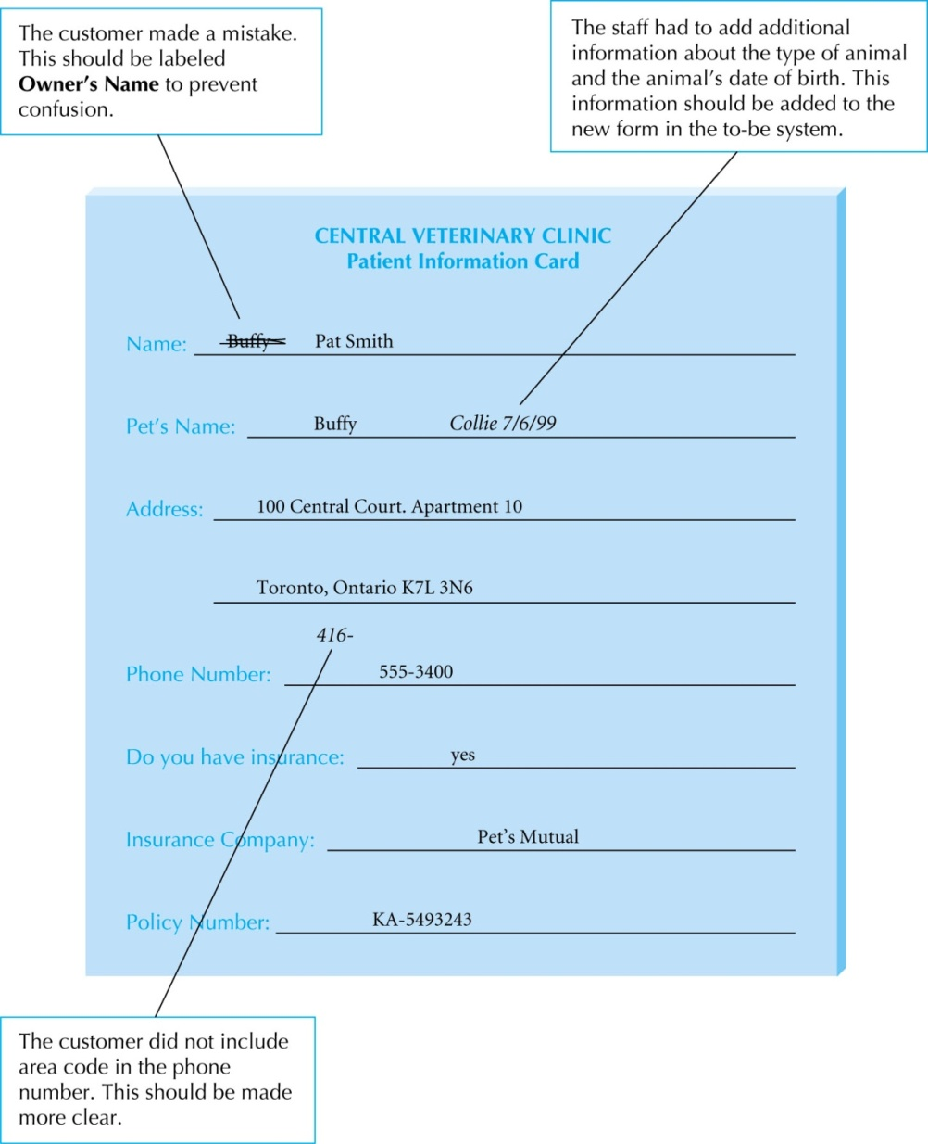
Performing Document Analysis

Slide 49
Observation
Users/managers often don’t remember everything they do
Checks validity of information gathered in other ways
Behaviors may change when people are watched
Workers tend to be very careful when watched
Keep a low profile
Try not to interrupt or influence workers
Be careful not to ignore periodic activities
Weekly … Monthly … Annually

Slide 50
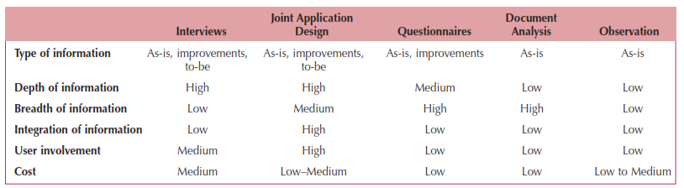
Requirements-Gathering Techniques Compared
A combination of techniques may be used
Document analysis & observation require little training; JAD sessions can be very challenging

Slide 51
Combining Techniques
Interviews with senior managers
understanding of the project and “big picture” issues
Document Analysis
Understanding of the as-is system
Interview
The rest of the information needed for the as-is system
JAD Session
Identifying improvements
Questionnaires to wider set of users
To see whether the opinions are widely shared

Slide 52
Alternative Techniques
Concept Maps
Represent meaningful relationships between concepts
Focus individuals on a small number of key ideas
* 기능 비기능 요구사항의 관계 표현 가능, 요구사항 추가발견 가능, 많아지면 복잡해짐
User Stories, Story Cards & Task Lists
Associated with agile development methods
Very low tech, high touch, easily updatable, and very portable
Captured using story cards (index cards)
Capture both functional and nonfunctional requirements.

Slide 53
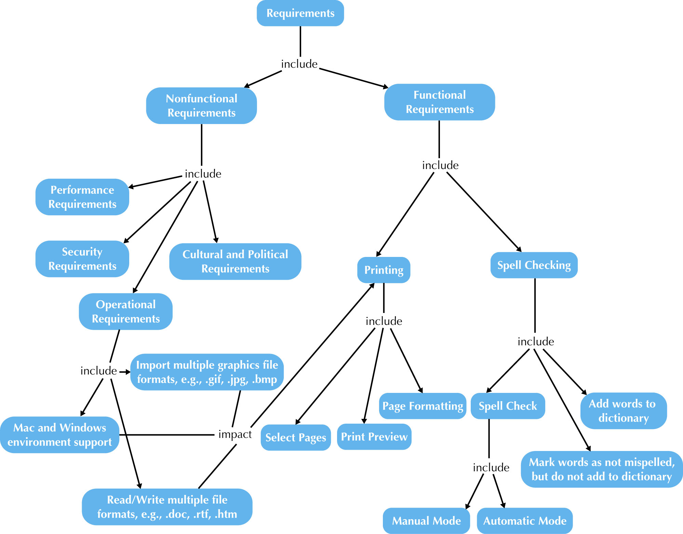
fig_04_12
Notes:
Concept maps

Slide 54
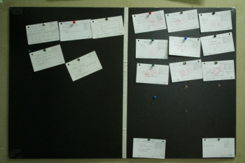
Story Cards & Task Lists
Capture requirement using story cards (index cards)
File card with single requirement
Each requirement (card) is discussed
How much effort is required to implement it
A task list is created for each requirement (story)
Large requirements can be split into smaller sections
The story can be prioritized by risk level and importance
Notes:
Story card ------ task lists
Task들이 너무 많으며 story를 분할한다.

Slide 55
The System Proposal
System request
+feasibility analysis result
+project plan
Planning & Analysis
System proposal
Planning(ch 2) analysys(ch3, ch4, ch5)
System proposal : 다음 페이지

Slide 56
The System Proposal
Combines all material created in planning & analysis
Included sections:
Executive summary
Provides all critical information is summary form
Helps busy executives determine which sections they need to read in more detail
The system request
The workplan
The feasibility analysis
The requirements definition
Current models of the system (expected to evolve)

Slide 57
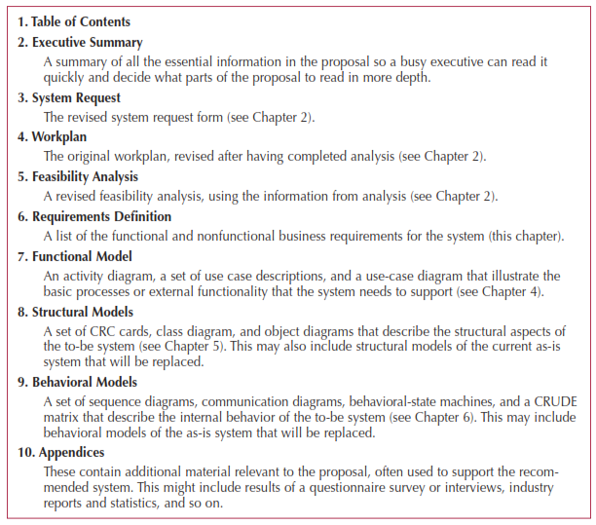
System Proposal Template

Slide 58
Summary
Presented in this chapter:
Discussion of functional and non-functional requirements determination
Requirements analysis strategies
problem analysis, root cause analysis, duration analysis, activity-based costing analysis, informal benchmarking analysis, outcome analysis, technology analysis and activity elimination
Requirements gathering techniques
Interviews, joint application development, questionnaires, document analysis and observation
Alternative requirements documentation techniques
concept maps, story cards and task lists
The system proposal

